Slide 1


DevOps to the Metal
Tom Jachmann Head of Software, Computed Tomography, Siemens Healthineers

Slide 2
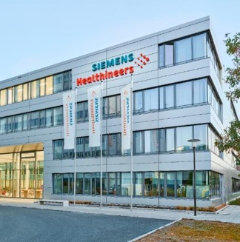
Siemens Healthineers (numbers prior to the Varian merger)
Market leader
~240,000
patient
touch points every hour
in majority of
businesses
Access to care for
>1.4bn people
€14.5bn
Revenue¹⁾
in developing
countries
>70%
>70
of critical clinical decisions are influenced by the type of technology we provide²⁾
countries with direct presence
~54,000
>90%
highly skilled
employees
of global top 100
providers partner
with us
18,500+
~600,000
IPRs, thereof 13,500 granted patents
installed base
1) Revenue FY 2020 2) AdvaMedDX, “A Policy Primer on Diagnostics”, June 2011, p. 3
Thomas Jachmann | Computed Tomography
2
Notes:
HOOD05162003156483
(partly re-used from HOOD05162003142082)
(partly re-used from HOOD05162003070821)
(partly re-used from HOOD05162003049771)
(partly re-used from HOOD05162003038686)
(partly re-used from HOOD05162002994040)
(partly re-used from HOOD05162002968065)
(re-use HOOD05162002913858)
(re-use HOOD05162002823352)
Main Messages
We are a significant player in the healthcare industry.
We bring the power of a globally operating corporation.
SPEAKER TEXT LONG
But why would you team up with Siemens Healthineers? Let us first share some facts & figures about our company:
With about 53,000 employees in more than 70 countries worldwide, we are committed to the success of you as our customers as well as to the health of your patients
We are the world market leader in most of our businesses and the market leader in most countries
With 14.5 bn revenue, we are one of the five largest MedTech companies worldwide
We are steadily reinvesting in R&D in pursuit of the next generation of technologies across our broad portfolio - Our R&D activities resulted in more than 18,500 Intellectual Property Rights (IPRs), thereof 13,500 granted patents
More than 70% of critical clinical decisions are influenced by the type of technology that we have in our portfolio
> 240,000 patients every hour benefit from care based on our equipment
> 1.4 bn people in developing countries have access to our imaging technologies

Slide 3
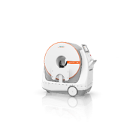
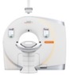
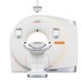
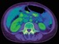

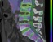
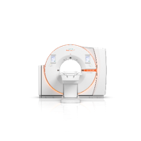
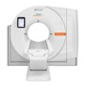
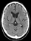
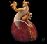
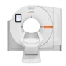
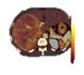

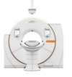

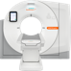
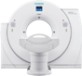
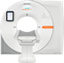
Innovating CT throughout a strong portfolio
Mobile Head CT
Dual Source CT
UpTime Services • UpSpeed Services • UpSkill Services • UpLift Services
ecoline
NEW
SOMATOM On.site²
with myExam Companion
Artificial Intelligence with the AI-Rad Companion
Low Dose Optimized Workflows
syngo.via Frontier¹⁾
Single Source CT
Acute Care
Dual Energy
SOMATOM Force
SOMATOM Drive
Single Source CT
SOMATOM go.Top
with myExam Companion
syngo.via
Neurology
Cardiology
SOMATOM X.cite
with myExam Companion
NEW
SOMATOM go.All
with myExam Companion
Oncology
Intervention
Pediatrics
SOMATOM go.Up
with myExam Companion
SOMATOM Edge Plus
SOMATOM go.Now
with myExam Companion
SOMATOM Definition Edge
For research use only. Not for clinical use.
SOMATOM On.site is pending 510(k) clearance, and is not yet commercially available in the United States.
Thomas Jachmann | Computed Tomography

Slide 4
The environment Cyber-physical system of systems: Computed Tomography scanners
Challenges
Growing complexity (both product and the organization)
Transforming from a hardware driven to a Software driven company causing functionality realized in Software to grow rapidly
Systems become increasingly interconnected, expanding the complexity beyond the boundaries of systems
Growing compatibility concerns between parts of large, complex systems because various parts move at different “pace of change”, especially combining Hardware and Software
Fast pace of change of modern software technologies requires clear separation of concerns
Accelerating innovation cycles
Thomas Jachmann | Computed Tomography
Notes:
War story. DevOps with the neighbor

Slide 5

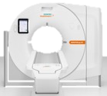

How to deploy regularly on the target system Difference to cloud-based SaaS
Cloud Application → One production system Homogenous System/SW Deployment
Master Ctrl
Wireless Remote Ctrl
Phys Meas.
Network Proc.
Remote Ctrl
Tube Control
Application
Detector
Scanner Application → more than 25000 systems Heterogenous System/SW Deployment
Device Module
Power Module
Motion Ctrl 1/2
Embedded Controller
Generator Control
Application Package
Control System
Table Control
Motion Ctrl 3
Reconstruction System
Motion Ctrl 4
3rd party Updater
SW Updater/Development Item
Embedded Device
Thomas Jachmann | Computed Tomography
Notes:
Car example?
Install the first system, downgrade to old version for „Continuous“ → FPGA, …
Defined system state on a scanner, reproducible

Slide 6
Challenge of “System-DevOps” in a regulated environment Vision: “Release as a Non-Event”
and here’s our “Ops”
Development (informal)
Verification & Validation (formal)
Integration Test
Deploy & Test in user equiv. Environment
Regulatory Testing….
“Regulatory Wall”
Plan
Code
Build
Test
Release
Deploy
Operate & Monitor
Continuous Operations
Continuous Deployment
V&V
Continuous Delivery
Continuous Integration & Test
Continuous Build
Development
Operations
Thomas Jachmann | Computed Tomography
Notes:
Benefits of running feature … everything before is just a liability
Integration effort is integrated
Product Management can verify the actual customer view … and correct things if needed
Example: accidentally broken functionality -> difficutlt to nail down the responsible change -> not so if it’s only one day of dev
How much time is actually spent on integration after “everyone finshed”?
→ Cone of Effort the later issues need to be analyzed
RUNNING FEATURE…
.. Not the ONLY metric but one , but this

Slide 7



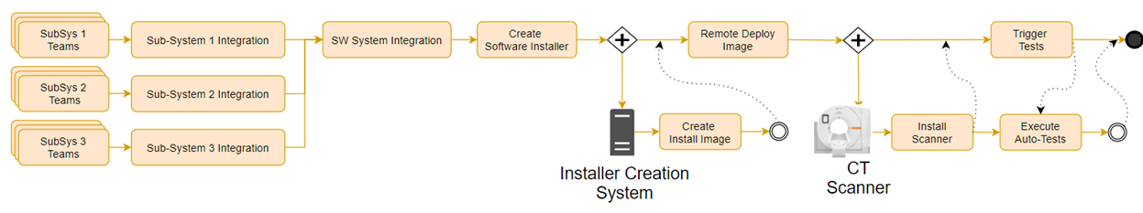


Fully Automated System Deployment Scope and Achievements
Automatic System installation
Efficient SW integration
Code Change
Deployment & Test
6 Weeks pre-planned and fixed Milestone Cadence
Continuous SW integration
Daily
4 Sites (DE, SK, IN, CN), > 150 SW Developers, 300 build & test systems, >130 individual Build-Queues
Thomas Jachmann | Computed Tomography
Notes:
shrink long time periods: Make hypothesis, conduct experiments.

Slide 8

Example Plateaus for Continuous System Integration
Main Stakeholder
Why
Goal
Test
4
System Integration as a "non-event"
System Engineering
Sys-Integration each milestone
Green to Green
3
On demand automated deployment
System Engineering
Early feedback on system state ensure smooth milestones
Plateaus
2
Inter-Sprint milestone feedback
System Engineering and SW Development
Avoid changes that break system during development of features
1
Daily feedback on installability
Installation and SW Development
Secure the base
Thomas Jachmann | Computed Tomography

Slide 9




Lessons learned Keep moving in the right direction
Balanced stimulus
Avoid that your endeavor stalls by getting lost in the details
Don’t rush to the next topic …
…but understand when a plateau is reached and reasonably secured …
…and then set a new stimulus/direction
Reachable beneficial plateaus
"Musts" for each plateau
Goals must be reachable
People must understand what benefit it brings for them
Celebrate small victories along the way
Conduct experiments, measure results
Complex environments require
Probe-Sense-Respond
KPI
KPI
Next plateau
Sustaining
S
KPI
KPI
Complex
Complicated
Chaotic
Simple
Thomas Jachmann | Computed Tomography
Notes:
Conduct experiements, measure results.
Focus on human angle: Wins are visible, Recognize successes
smaller chunks = more opportunitites for motiviation

Slide 10


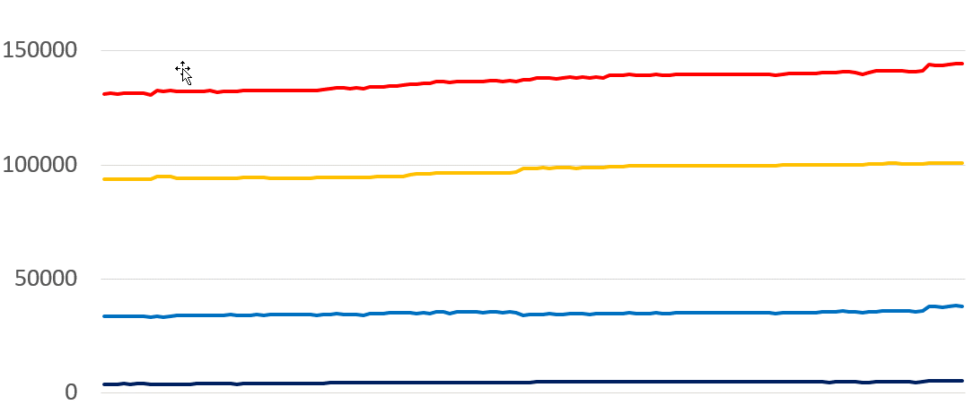

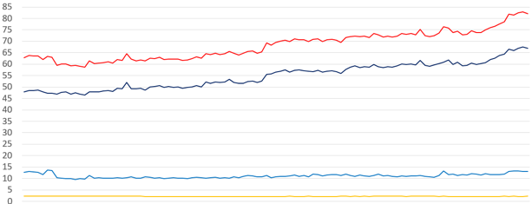
Example Plateaus for Continuous Integration
Test Pyramid
Test
All
High autotest
coverage
System
Unit
Subsystem
Integration
Integration
Subsystem
Unit
t
h
All
Scaling Test Infrastructure
Subsystem
Balanced Test Pyramid ("Shift Left")
Integration
Unit
t
Thomas Jachmann | Computed Tomography
Notes:
https://commons.wikimedia.org/wiki/File:Deming_PDCA_cycle.PNG
Expect and deal with this evolution. Uncovering problems is a value. Celebrate the skunks

Slide 11








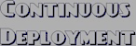
DevOps brings transparency …
… and uncovers all of the (bad) things hidden underneath
Thomas Jachmann | Computed Tomography
11
© Siemens Healthineers, 2021

Slide 12












































DevOps is a journey
Test Pyramid
Test Automation
Smooth SW installation
Robust Test Infrastructure
High autotest coverage
Automatic worldwide deployment
Smooth System installation
Balanced Test Pyramid ("Shift Left")
Scaling Infrastructure
Craftsmanship and Continuous learning
Stable and scaling Infrastructure
Efficient SW development
Efficient Auto Testing and TDD
Robust Updates and Upgrade
Digital Twin
Minimize downtime
Automatic System installation
Continuous SW
Verification
Continuous delivery of value
Continuous Deployment
Efficient tooling, automation
Minimize interruption of customer schedule
FLOW
Efficient way of working
Modularization, Sandboxing
Trunk-based development
Continuous System Integration
Robust
Packaging
SW Integration
Ability to Continuously release
No breaking
changes
Operations
Infrastructure
as Code
Field transparency
Artifact based integration
SW verified SW
Continuous SW integration
Fast Feedback
Release independence of modules
Scaling
Infrastructure
High product quality
Efficient SW integration
Thomas Jachmann | Computed Tomography
Background image: https://www.mapsland.com/europe/large-detailed-satellite-map-of-europe-at-night
Notes:
“Many roads lead to Rome” IaC = Infrastructure as Code, auch Desired State Configuration DSC im Allgemeinen

Slide 13
Takeaways
DevOps is not about a destination, it’s about the journey
1
Culture and Mindset for continuous improvements is a decisive factor throughout the organization (from development teams to top management)
2
Establishing automated fast feedback cycles, even when not yet doing continuous delivery all the way to the end customer – it is important to steer and learn
3
Pick the right KPIs that allow you to have success stories and celebrate them
4
Strive to meet the overall goals of the various involved roles, but allow freedom on *how* to achieve them (e.g. mostly automated with final sanity check vs. manual). Create wins for them.
5
Accept that approaches will not show the results you expect – remember it is a complex environment with only emerging practices. So: Probe-Sense-Respond
Thomas Jachmann | Computed Tomography
Notes:
Empbrace scientific method, the journey

Slide 14
Credits
Siemens Healthineers
SHS DI CT R&D ISA
Siemens Healthcare GmbH
Siemensstr. 3
91301 Forchheim, Germany
siemens-healthineers.com
Thank you to the following experts involved in the creation of the presentation:
Frances Paulisch
Chris Drexler
Dave Malgiaritta
Jochen Michel
Thomas Jachmann | Computed Tomography

